Slide 1
PhoneGap and Xamarin: Your Excuse to Not Write Your Mobile App is Gone
Jerrel Blankenship & Jamie Dicken

Slide 2
Who We Are
Jerrel Blankenship
@TheJerrel
Software Engineer at RelayHealth
Author: Pro Agile .NET Development with Scrum
Striving Software Craftsman
Certified Scrum Master
Jamie Dicken
@DotNetGeekette
Software developer and team lead at RelayHealth
Mobile enthusiast
Volunteer at Per Scholas

Slide 3
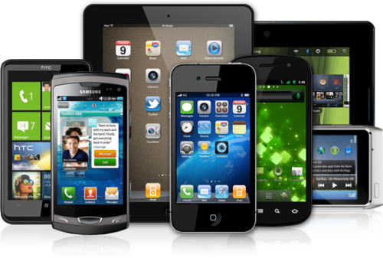
Which One Do I Choose?

Slide 4
Frameworks To The Rescue
PhoneGap
Xamarin
AppMobi
Unity
Appcelerator
Adobe Flex

Slide 5
PhoneGap

Slide 6
What Is PhoneGap?
Open-source
Single codebase
Support for iOS, Android, Windows Phone, Blackberry, webOS

Slide 7
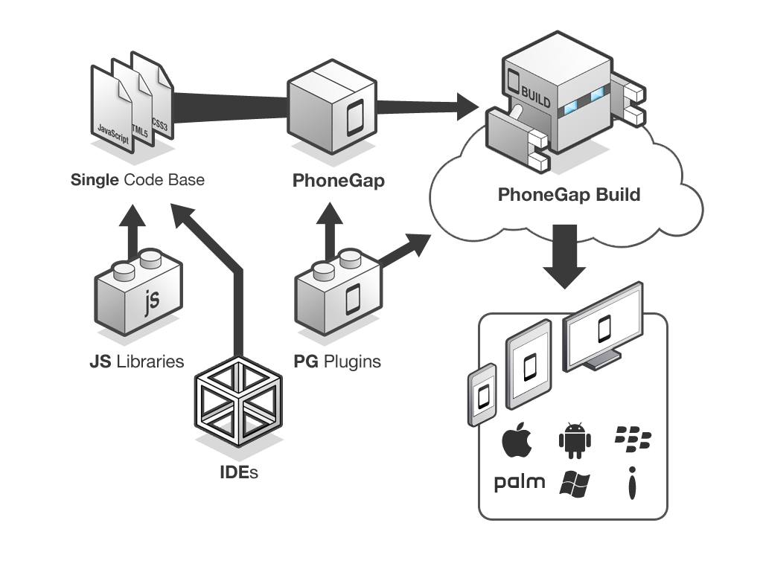
PhoneGap Overview

Slide 8
Let’s Create an App!

Slide 9
Xamarin

Slide 10
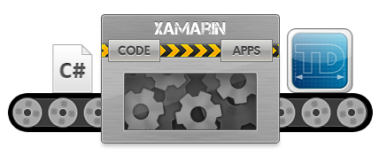
Xamarin Details
Cross-platform development with C#
Create native apps using Native APIs
Use any existing .NET Libraries
Notes:
Xamarin contains a fully functional implementation of the .NET runtime, called Mono, which is bundled with your app so that your code executes with all of the power of C# and .NET, including memory management, reflection, and the .NET base class libraries
Can develop Android and iOS apps
iOS requires network connection to Mac
Xamarin's binding technology exposes all of the APIs available in iOS and Android to your applications as regular C# class libraries.
This means your Xamarin application can do anything a platform, or device, offers, with native user interface and excellent performance.
Xamarin compiles your app to a native binary, not cross-compiled, and not interpreted.
Visual Studio Integration

Slide 11
Let’s Create an App!

Slide 12
PhoneGap v. Xamarin: Which do I choose?

Slide 13
Key Considerations
Cost
Performance
Supported platforms
Native app experience

Slide 14
Questions?
Notes:
Jamie: Well, there you have it – two very different tools for creating cross-platform mobile applications. One leverages your web skills of HTML, CSS, and Javascript. The other allows you a cleaner way to have a different user interface per platform, easily making your apps seem much more targeted per environment and therefore enhancing the user experience.
Jerrel: And with that, your excuse to not write your mobile app is gone!

Slide 15


Slide 16
Contact Us
Jerrel Blankenship
Jerrel@jerrelblankenship.com
@TheJerrel
www.jerrelblankenship.com
Jamie Dicken
Jamie@dotnetgeekette.com
@DotNetGeekette
www.dotnetgeekette.com
Slide Deck Link:
http://bit.ly/16wOVaP

Slide 17
Image Attributions
Diagram - PhoneGap Overview by Adobe / Yohei Shimomae
Smart Phone, Tablet, and PC – The Droid Guy

Slide 18
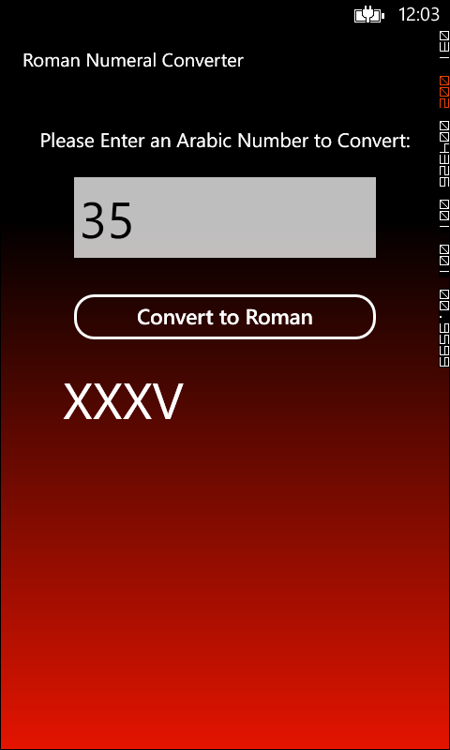
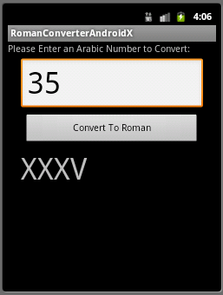
Xamarin App Comparison
Windows Phone 8
Android

